Slide 1
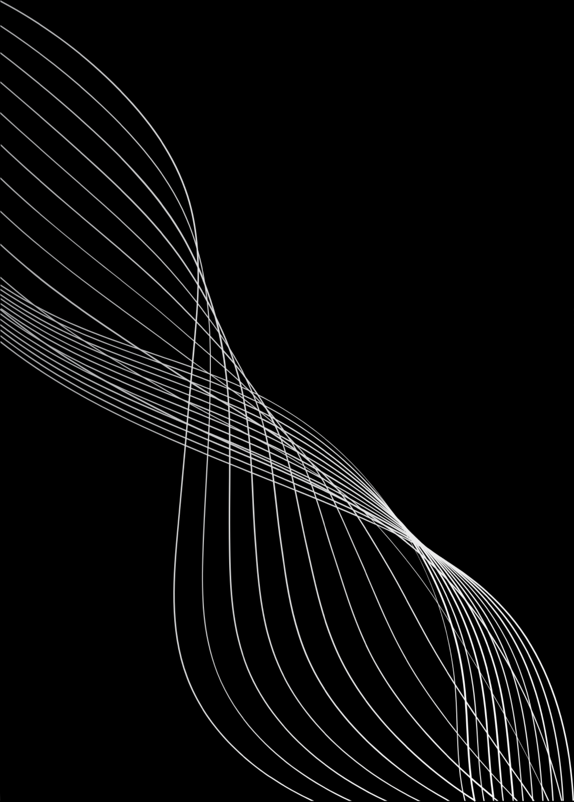


UIRADAR
An Application for UI Defects Detection
[Ms.Kadambari Jadhav - 250245920036]
[Mr.Aditya Wankhade-250245920003]
[Ms.Shruti Rasane-250245920070]
[Mr.Pravin Yalameli-250245920066]
[Mr.Ganesh Tambale-2502459200089]
Institute of Emerging Technologies
PG-DAC Batch: February 2025

Slide 2
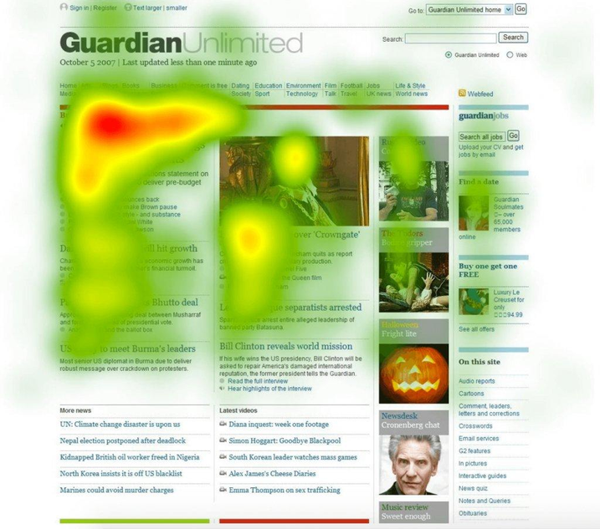
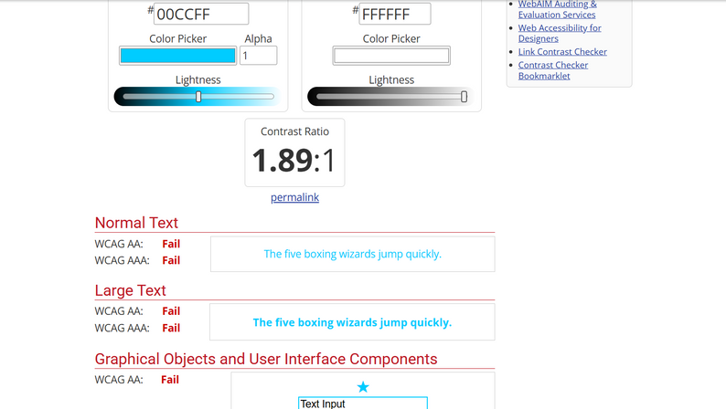
KEY CONCEPTS:
Q)What is a Heatmap?
A visual tool that simulates user attention on UI elements using color intensity.
Q)What is WCAG?
Web Content Accessibility Guidelines that checks for contrast violations, text readability, and accessibility flaws.
Q)Why & How?
Used to analyze focus areas in UI based on static screenshots.

Slide 3
ABSTRACT
UI Radar is a web application that used for detection of visual UI issues in screenshots.
Analyzes UI screenshots using heatmaps and WCAG standards
Generates bug reports with annotations and recommendations
Built using React, ASP.NET Core, Razorpay, Azure Blob, MYSQL

Slide 4

PROBLEM DEFINITION & SCOPE
Problem Defination:
Manual UI testing is slow, error-prone, and inconsistent.
Multiple tools are needed for different types of UI and accessibility testing.
Lack of a unified platform leads to fragmented testing workflows.
Visual bugs and accessibility issues often go undetected until after deployment.
There's a strong need for early detection of UI issues before production release.

Slide 5
PROBLEM DEFINITION & SCOPE
Scope:
Automate bug and accessibility detection
Visualize bugs with heatmaps
Provide downloadable PDF reports
providing one platform for combined solutions like heatmaps,WCAG color corrections,

Slide 6

GOALS & OBJECTIVES
Generate structured reports and annotation specified with Bug Detection.
Upload and analyze UI screenshots
Detect layout/accessibility issues
Create a Revenue Generating for real world needs.

Slide 7
CONSTRAINTS & EXPECTED OUTCOMES
CONSTRAINTS:
EXPECTED OUTCOMES:
WCAG detection accuracy, heatmap limitations
Processing overhead, third-party API dependencies
Data privacy.
Automated WCAG audits (AA, AAA)
Heatmap-based suggestions
Downloadable reports
Admin dashboard with analytics.
Super Admin will have control over all Applications.

Slide 8
SOFTWARE REQUIREMENTS
Frontend: React.js
Backend: ASP.NET Core Web API
Database: MYSQL
Storage: Azure Blob
Payment Gateway: Razorpay API

Slide 9
PROPOSED SYSTEM FEATURES
Screenshot upload and processing
Heatmap UI detection
WCAG color contrast validation
PDF report generation
Subscription and payment integration

Slide 10
PERFORMANCE REQUIREMENTS
Responsive UI on multiple devices
Scalable API response time
Secure storage for images and user data
Optimized DB and image processing

Slide 11
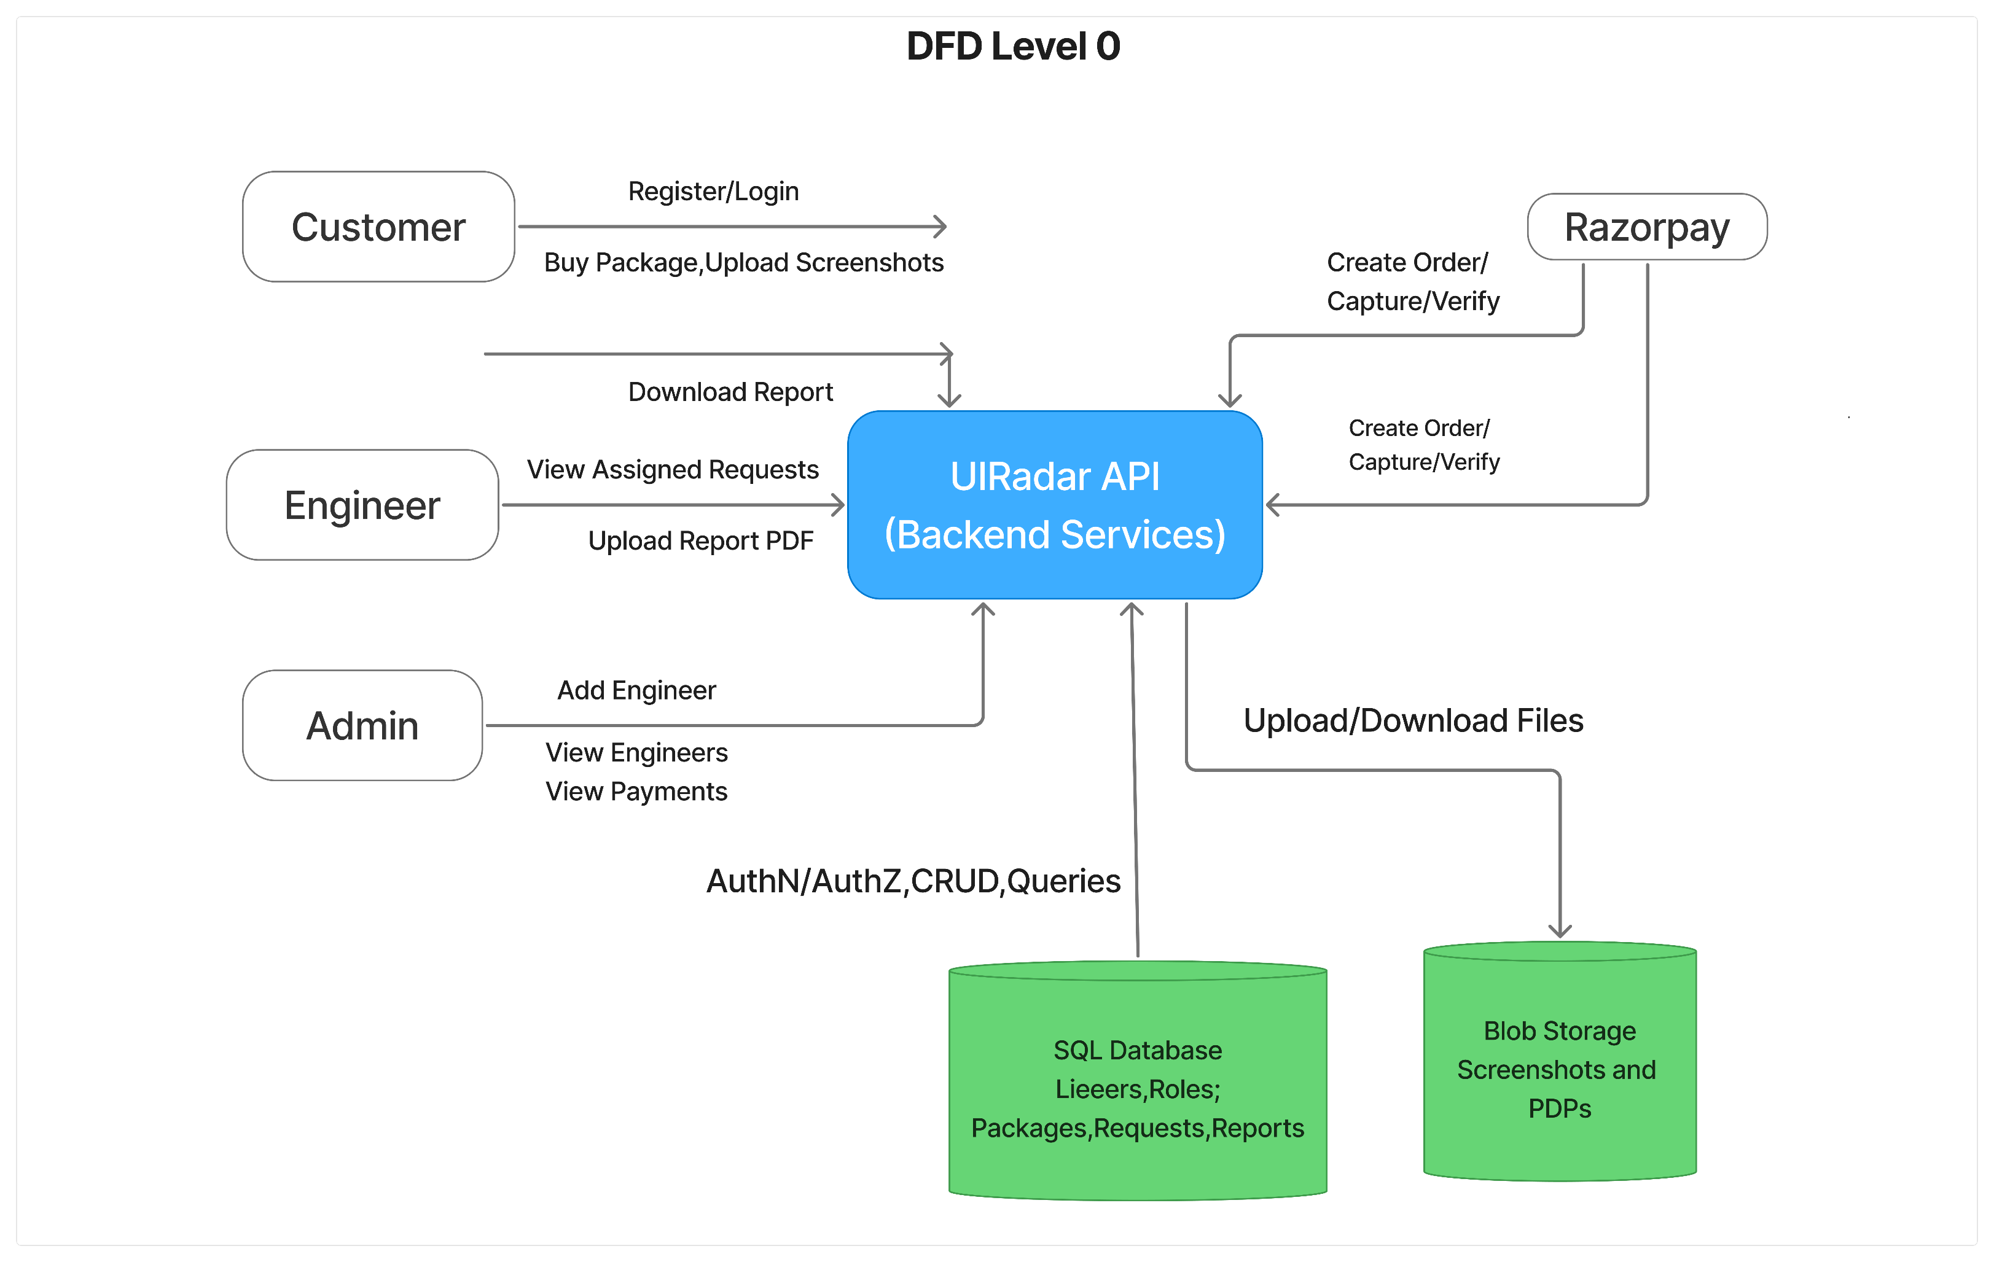
DATA FLOW DIAGRAM: Level Zero

Slide 12
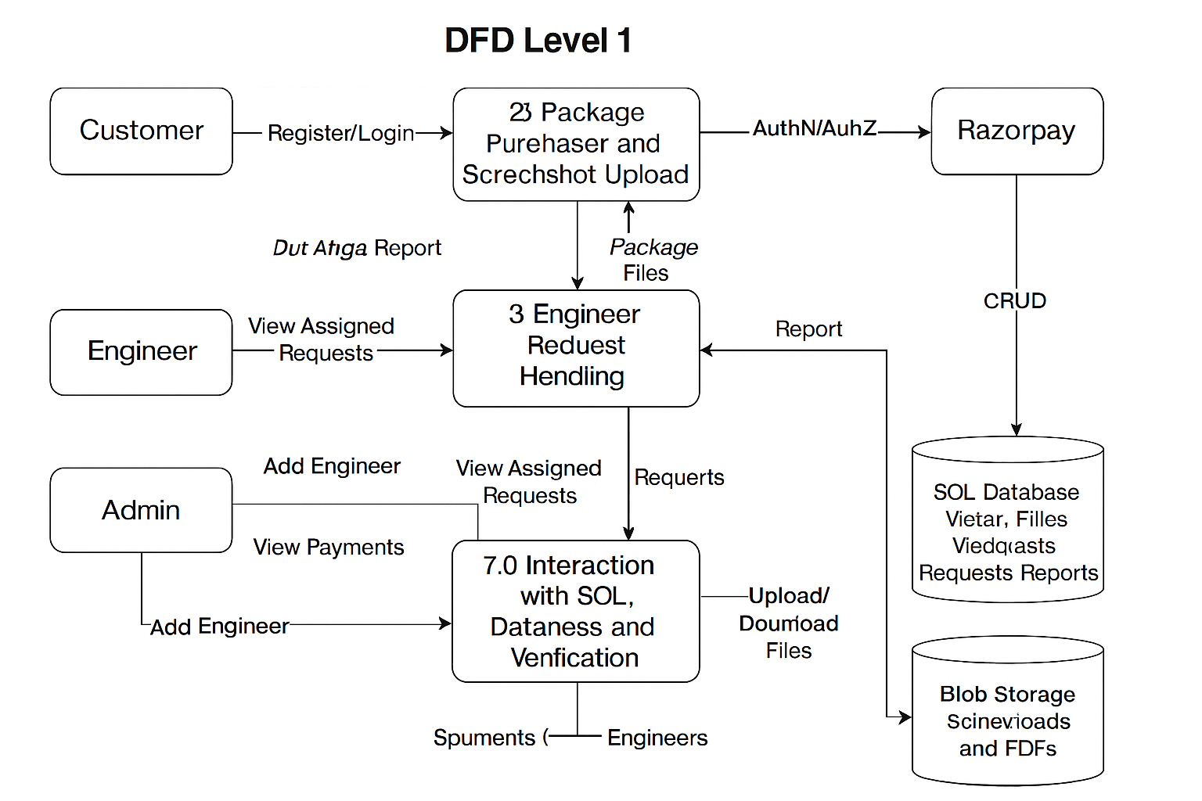
DATA FLOW DIAGRAM: Level One

Slide 13
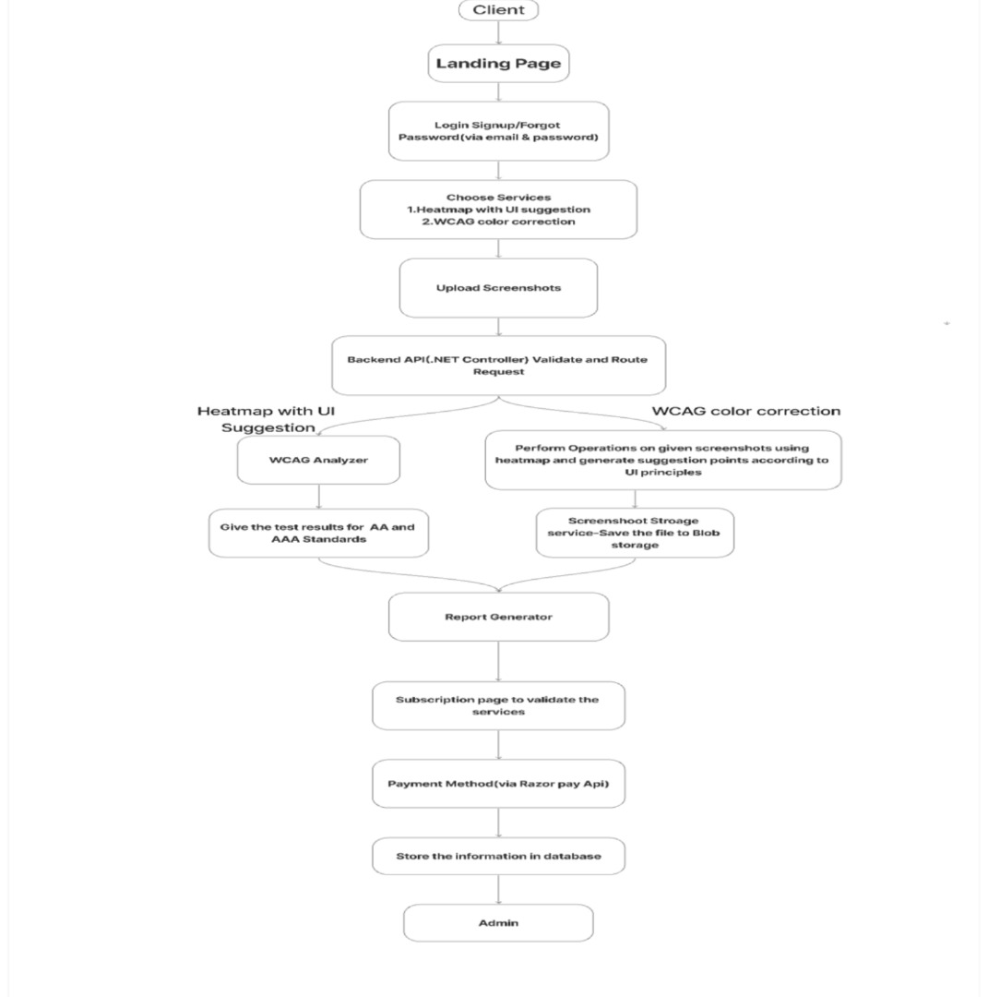
DATA FLOW DIAGRAM:

Slide 14
USE CASE DIAGRAM:

Slide 15
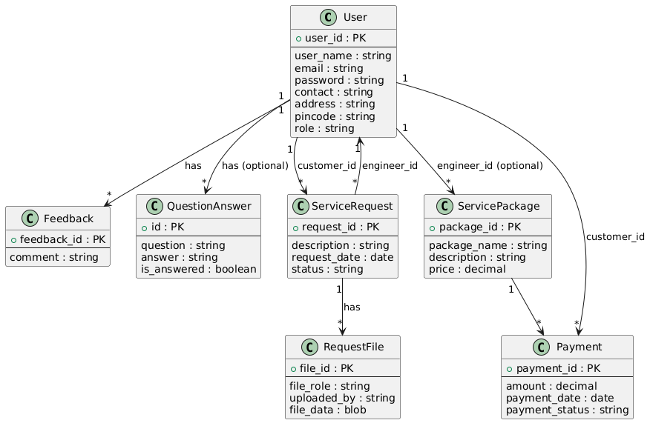
CLASS DIAGRAM:

Slide 16
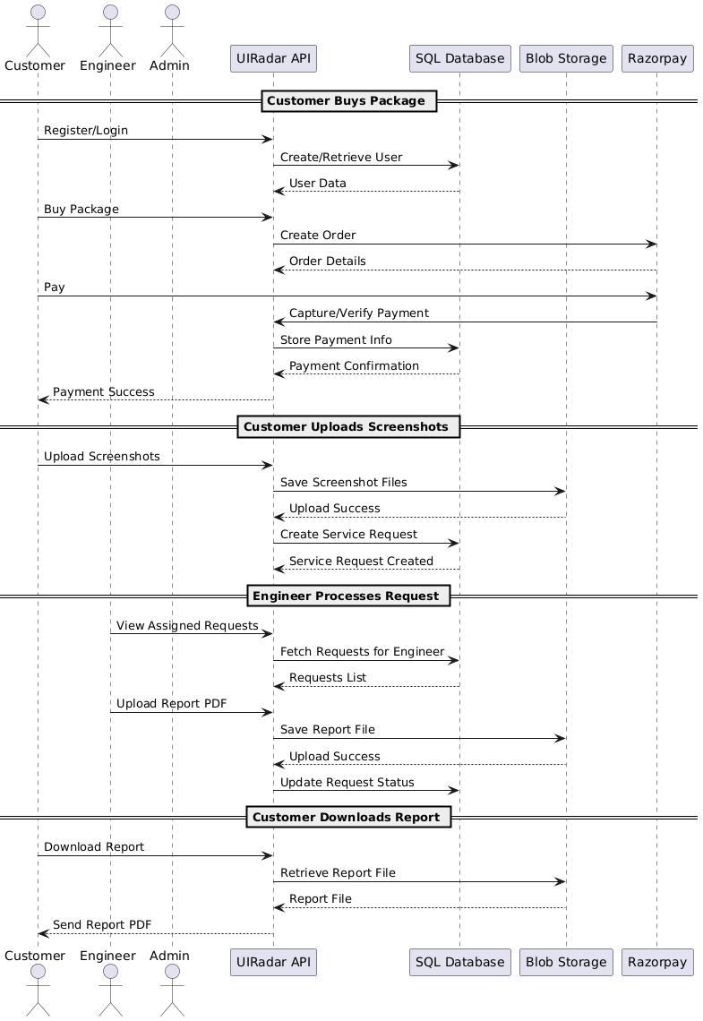
SEQUENCE DIAGRAM:

Slide 17
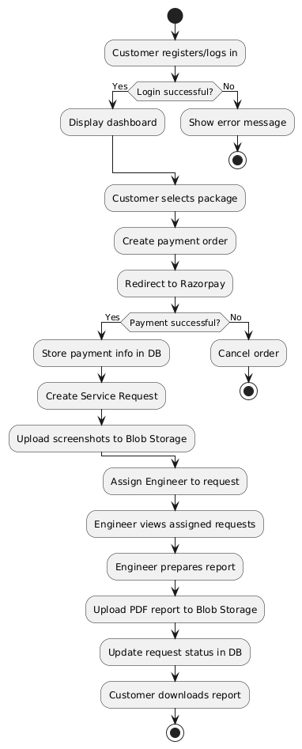
ACTIVITY DIAGRAM:

Slide 18
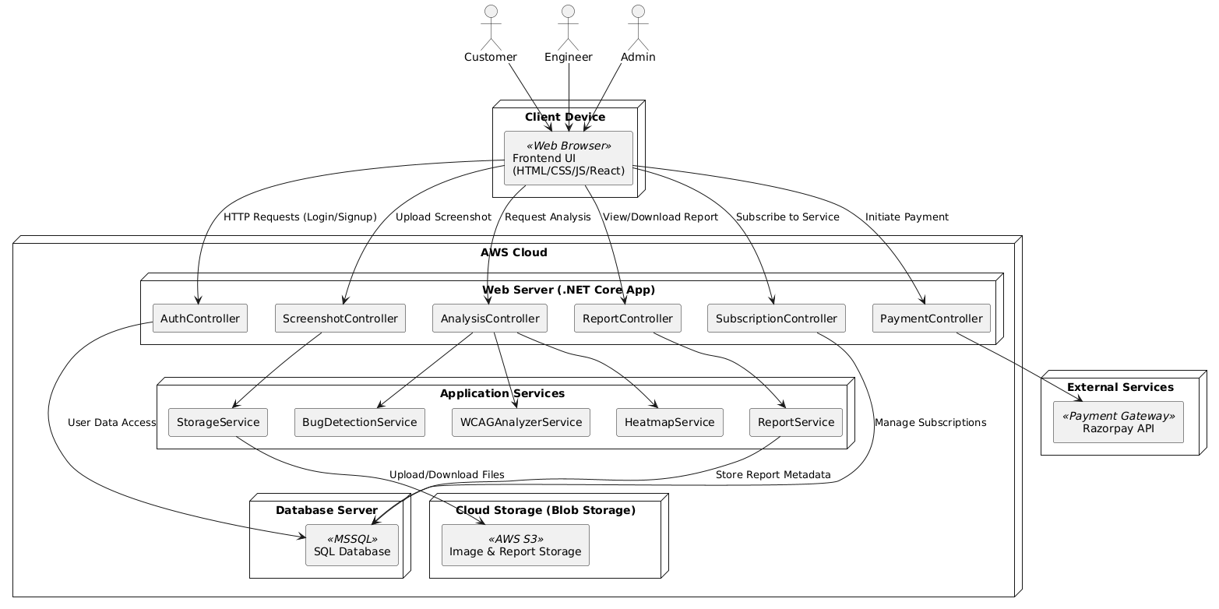
DEPLOYMENT DIAGRAM:

Slide 19
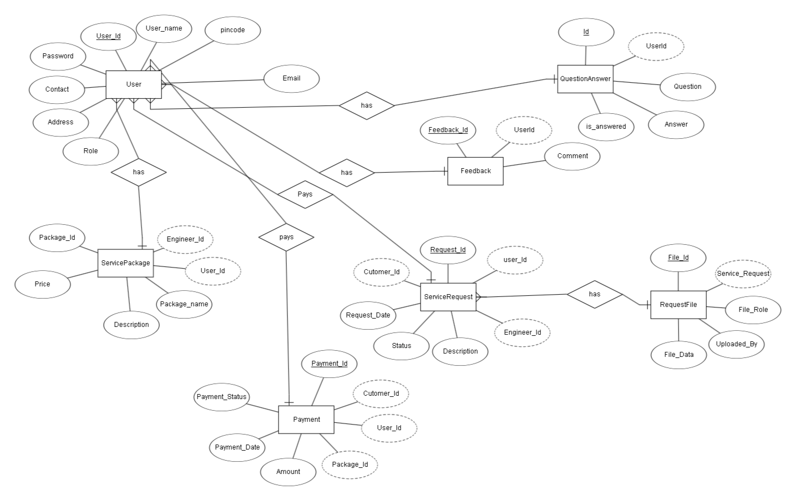
ER DIAGRAM:

Slide 20
THANK YOU

